Slide 1

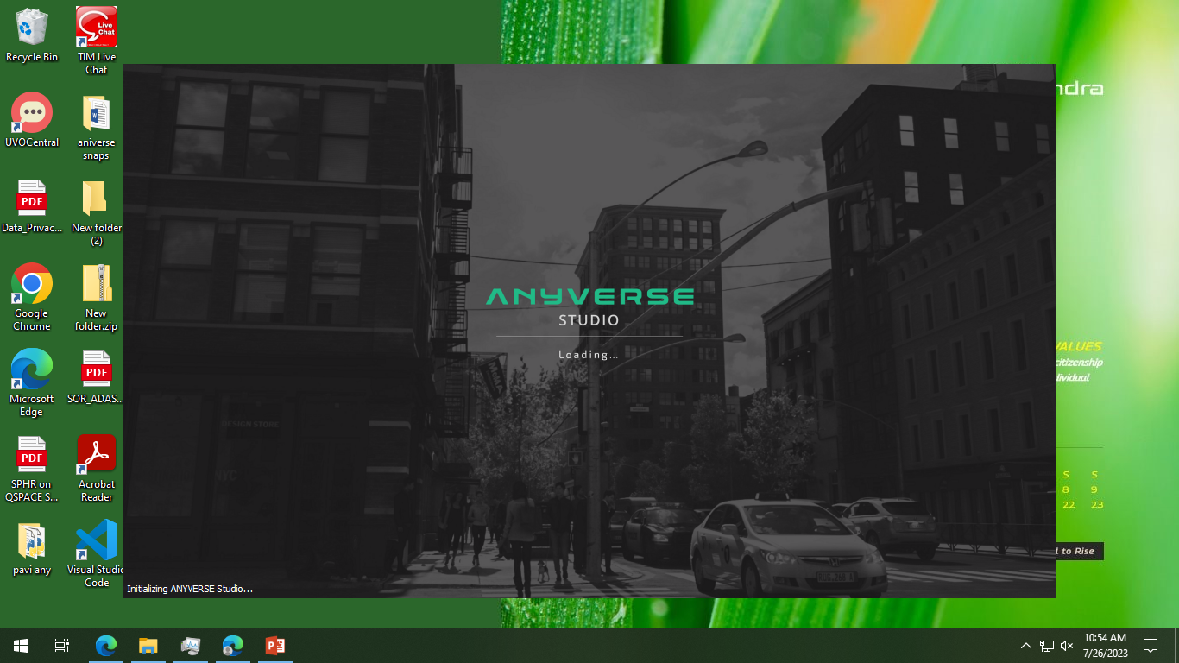
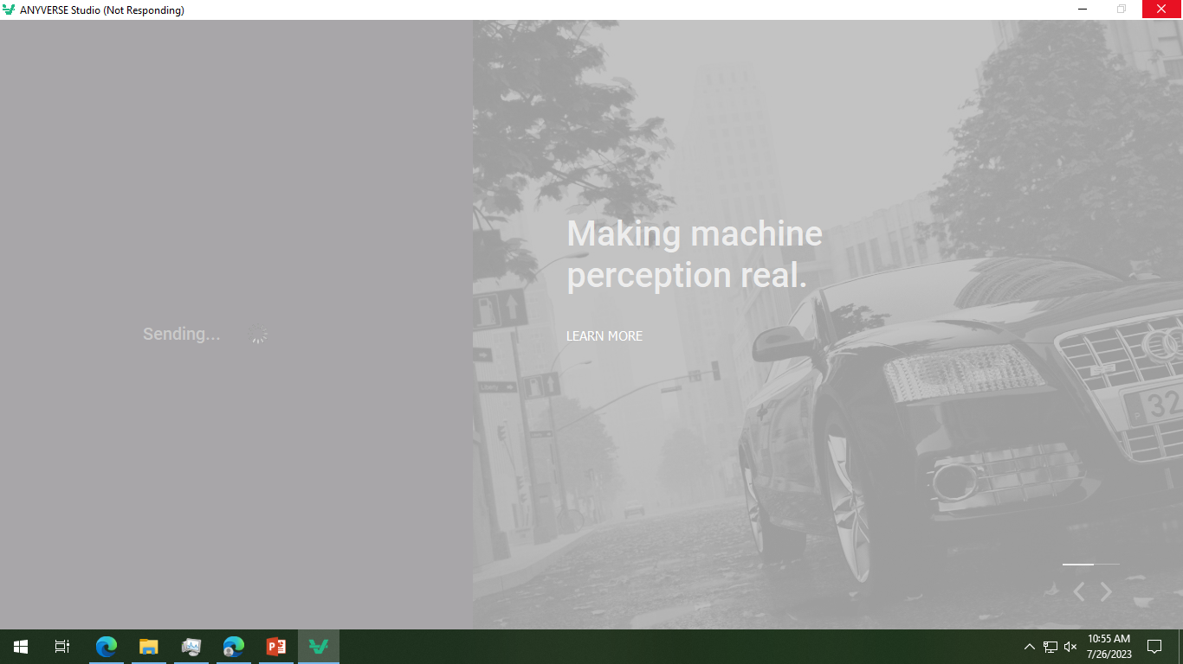
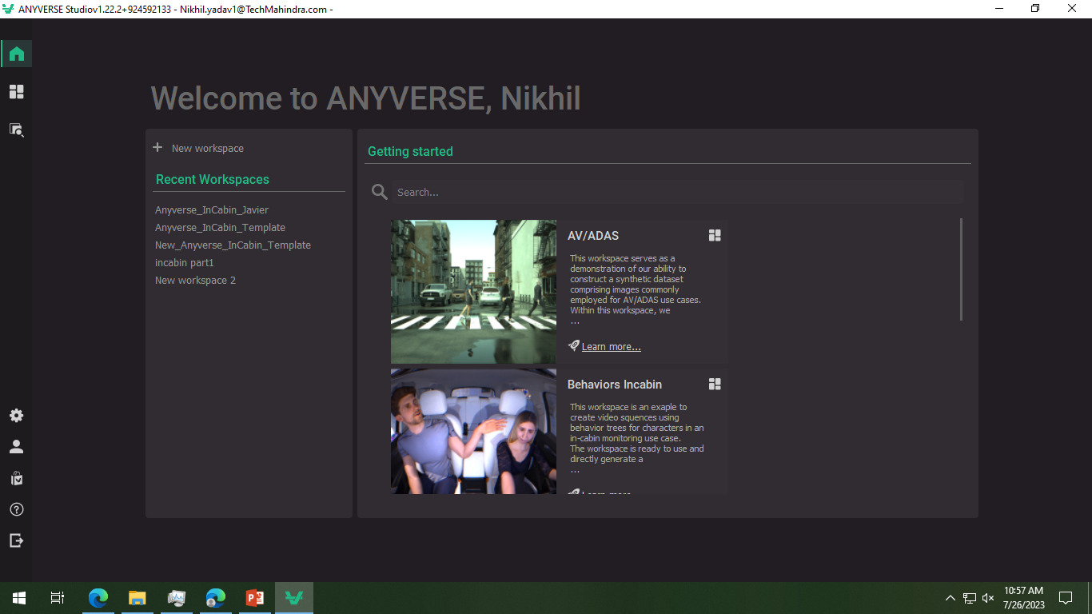
Anyverse offers a scalable synthetic data software platform to design, train, validate, or fine-tune our perception system. It provides unparalleled computing power in the cloud to generate all the data we need in a fraction of the time and cost compared with other real-world data workflows.

Slide 2
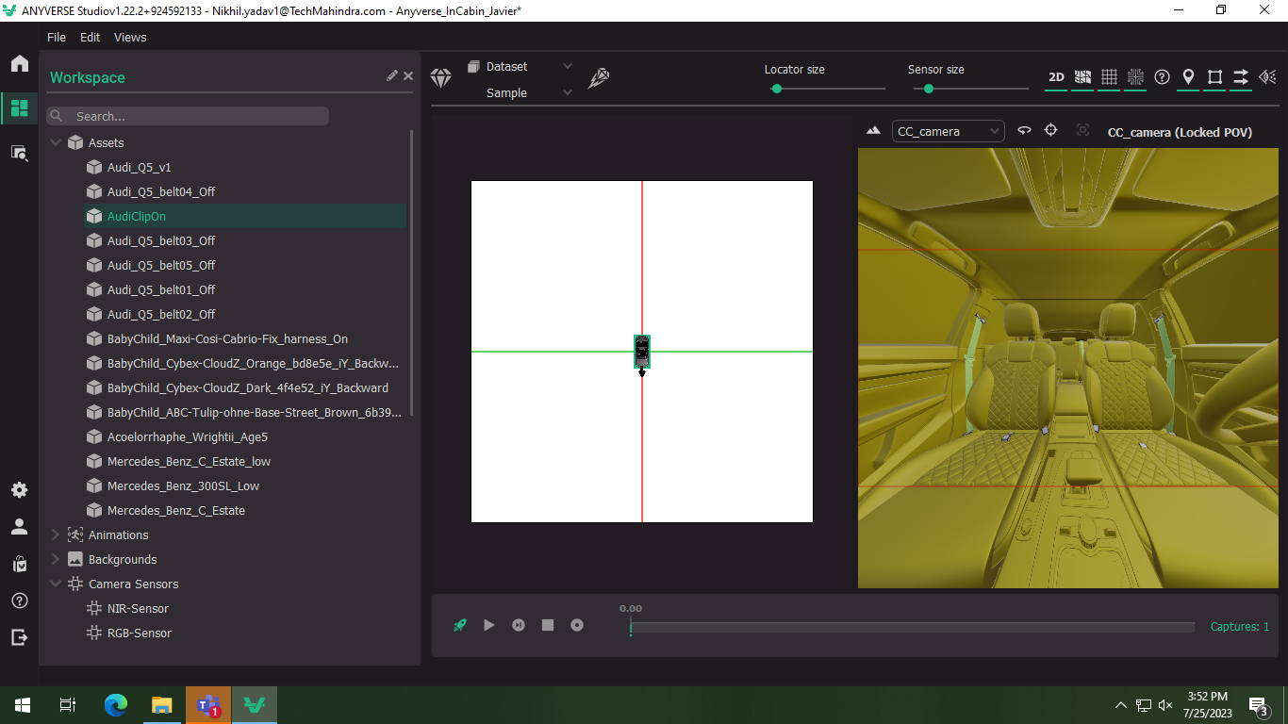
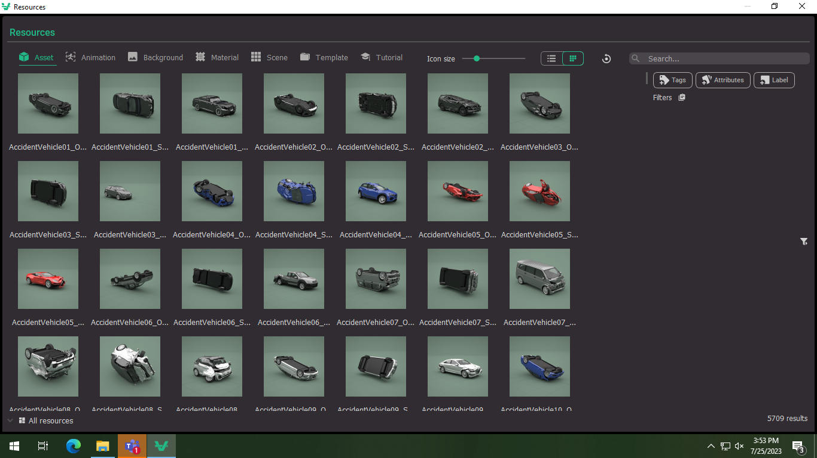
Steps to create in-cabin images
1. Assets
You can change the assets by adding new assets by adding new assets to the workplace from the resources view and change the reference to the assets in properties for the simulation

Slide 3
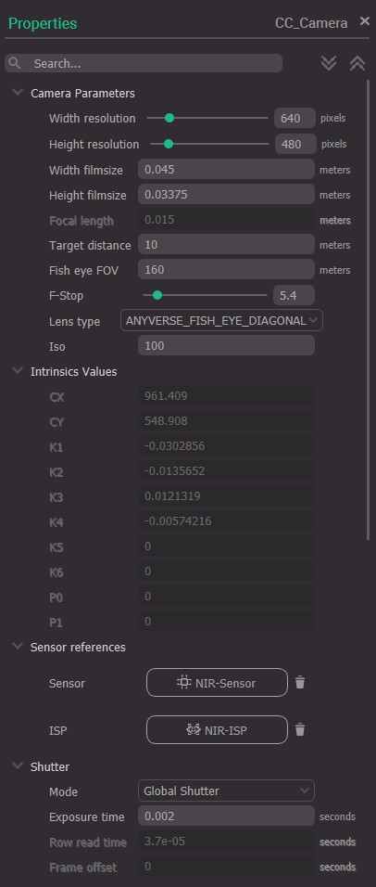
2.CAMERA
Resolution: width and height of you camera sensor in pixels.
Film size: actual width and height of the sensor in meters
Focal length of the camera lens. Disabled for fisheye lens types
Target distance: maximum target distance
Fisheye FOV: The field of view in degrees for fisheye lenses. Disabled for other types of lenses
F-Stop: camera aperture
Lens type. Anyverse provides different analytical lens models:
PIN_HOLE. Perfect lens
ANYVERSE_FISHEYE_CIRCULAR. Circular equidistant fisheye distortion model
ANYVERSE_FISHEYE_DIAGONAL. Diagonal equidistant fisheye distortion model
ANYVERSE_SPHERICAL. Spherical lens analytical model.
ANYVERSE_THIN_LENS. Thin lens model
OPENCV. For OpenCV calibration intrinsics.
OPENCV_FISHEYE. For OpenCV fisheye calibration intrinsics

Slide 4
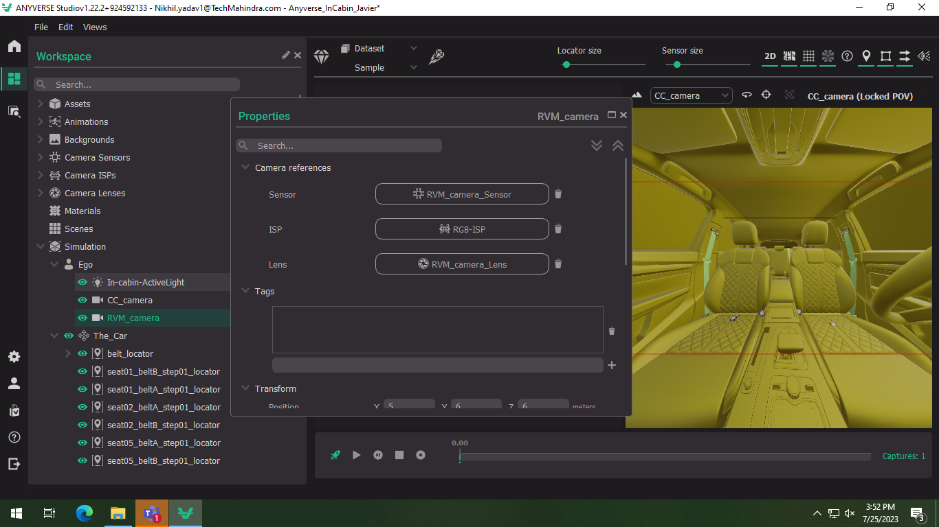
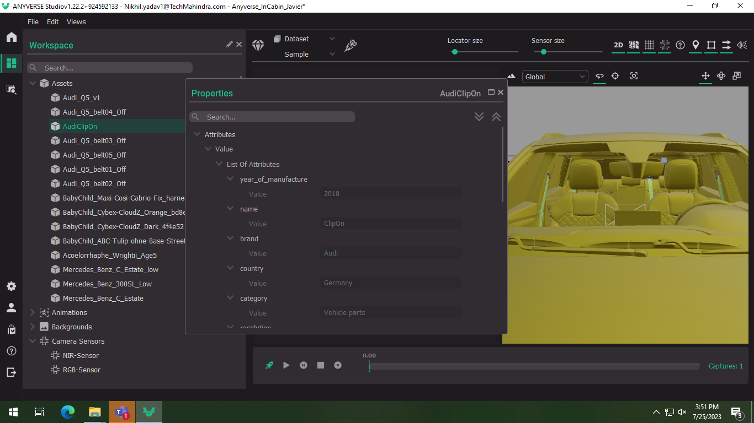
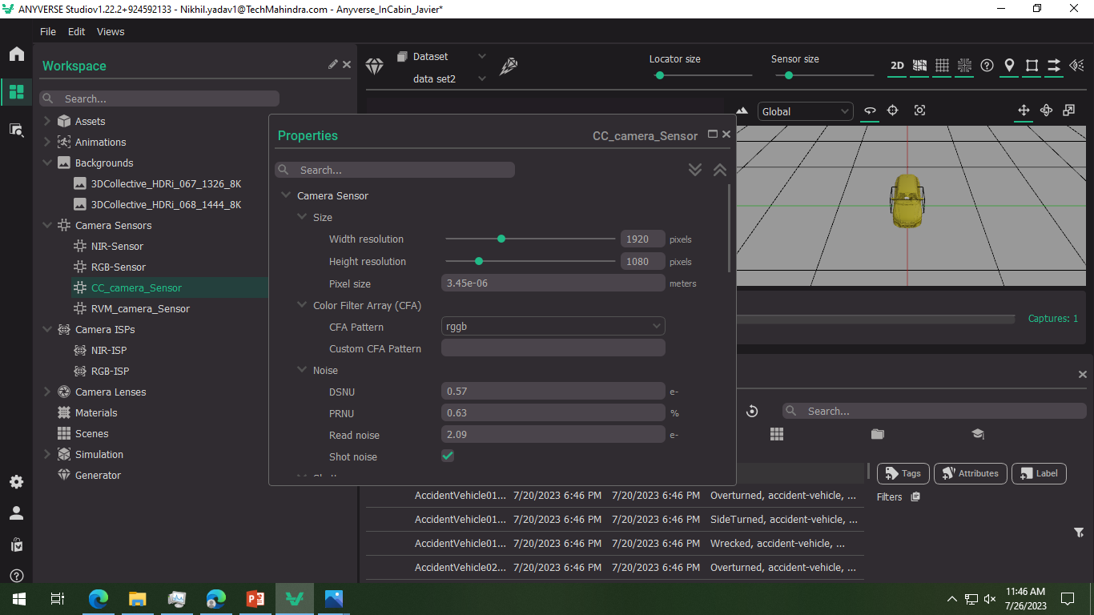

Slide 5
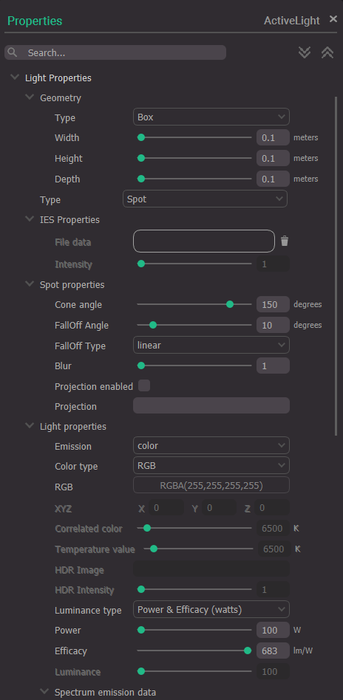
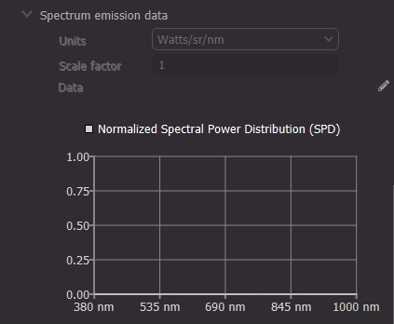
3.INTERIOR LIGHT
Here we can define your own artificial light source. In the case of the in-cabin use case, it is very common to have a source of light illuminating the scene. This happens always when using a NIR or RGB-IR camera that have an active light illuminating .
In this workspace there’s spot emitter between both cameras. We can turn it on or off (as any other element in the workspace) by clicking the icon right by the name in the workspace.

Slide 6
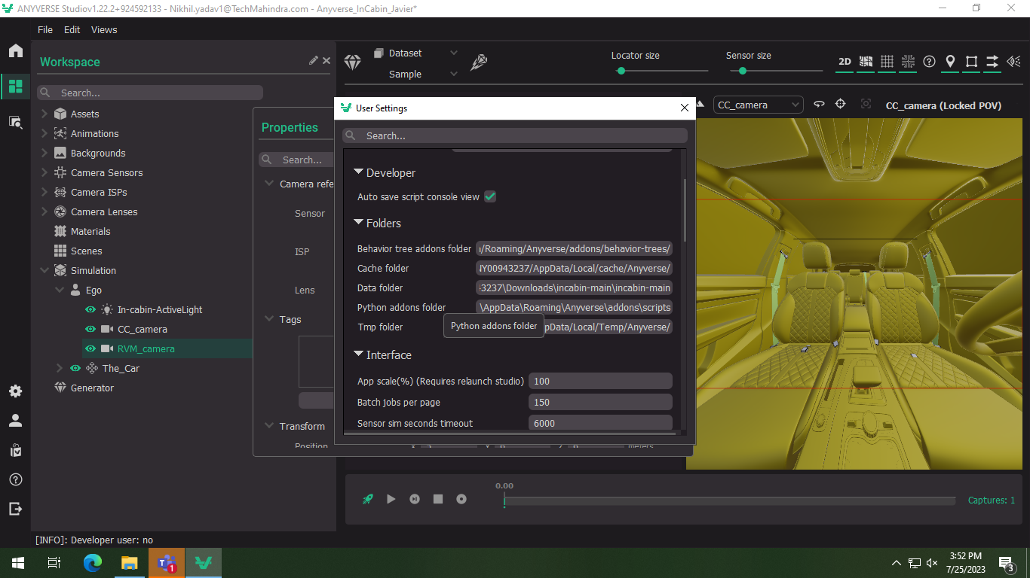
4.Adding Add-ons from Git-hub
Clone the in-cabin add-ons from the git-hub AnyverseAddons/incabin (github.com)
And add the paths in user settings.

Slide 7
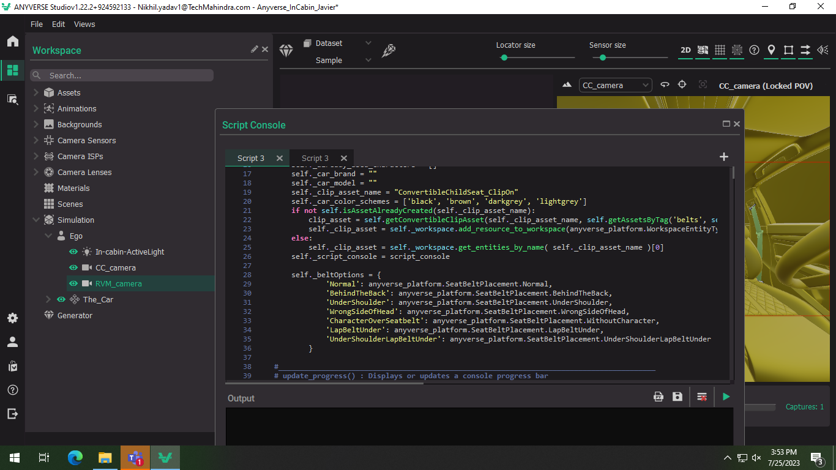
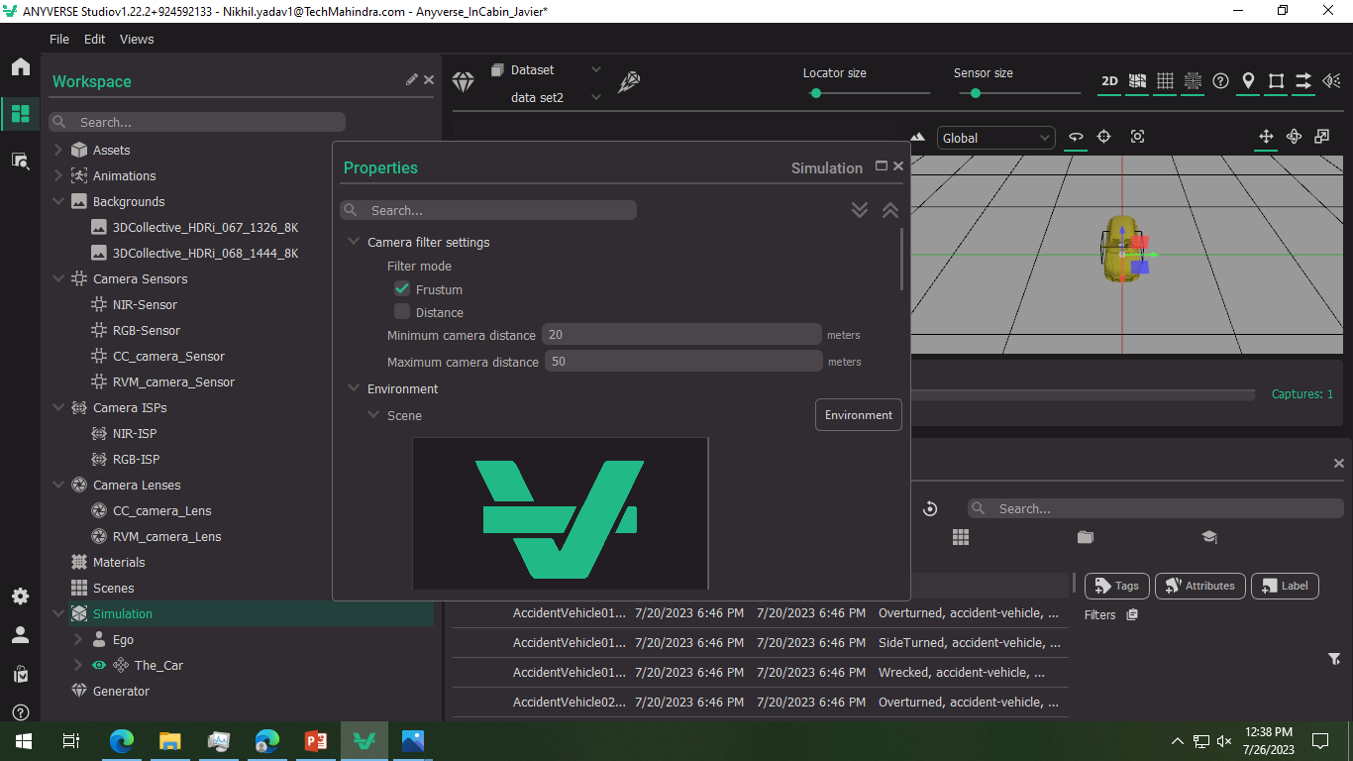
5.Run the simulation and code

Slide 8
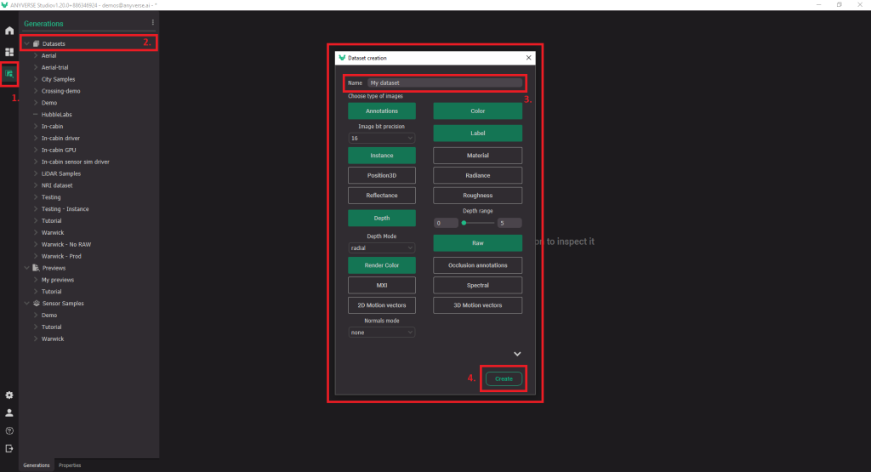
6.Generate a sequence
To generate a sequence from our workspace, we first have to create a dataset with the output channels we require. Go to the generator inspector space , and fallow the steps as showed in the picture

